Slide 1
FAradAy’s Laws of electromegnetic induction
Presentation by:
Mohammad Durvesh and Ibrar ali

Slide 2
Table of contents:
Introduction to the Topic
Components
Working(Table)
FAQs(Frequently Asked Questions)
Applications
Numericals
Conclusion

Slide 3
First Statement of Faraday’s Law of EM Induction:
Whenever there is a change in magnetic flux linked with a conductor, an EMF is induced in the conductor. If the conductor forms a closed circuit, an induced current flows through it.
Second Statement of Faraday’s Law of EM Induction:
Whenever there is a relative motion between a coil and magnet, an EMF is induced in coil. If the conductor forms a closed circuit, an induced current flows through it.

Slide 4
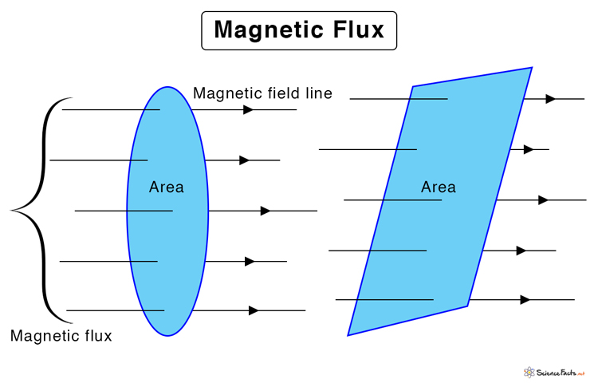
Magnetic Flux is the number of field lines passing perpendicular to a surface.

Slide 5
Induced EMF is related with:
Time(∆t) inversely
Strength of Magnet(B) directly
Angle Between Coil and Magnet(cosθ) directly
Number of turns of coil(N) directly
Area of Coil(A) directly
Which makes:
ε = -NBAcosθ/∆t
(we know that: Magnetic flux(∆∅ = BAcosθ) )
So the formula becomes:
ε = -N (∆∅/∆t)
Where:
N = Number of turns in coil
∆∅ =Magnetic Flux
∆t = Time

Slide 6
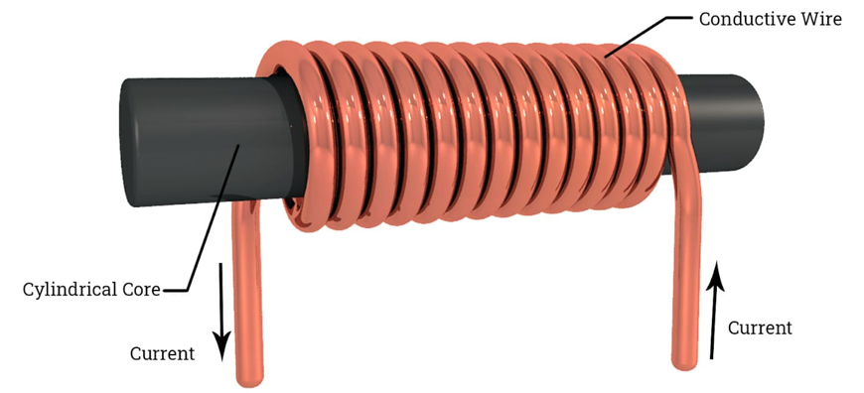

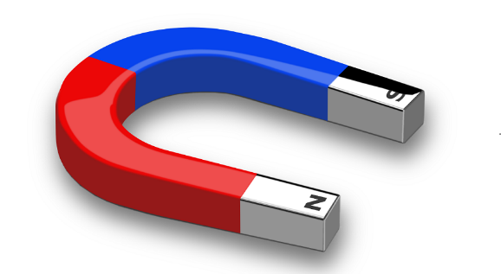

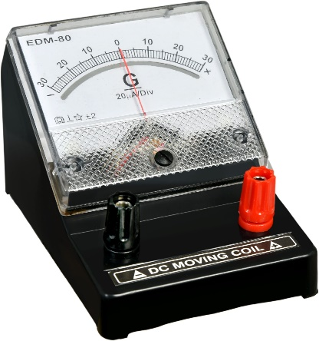
Components used:
Coil and Wire
Magnet
Galvanometer

Slide 7
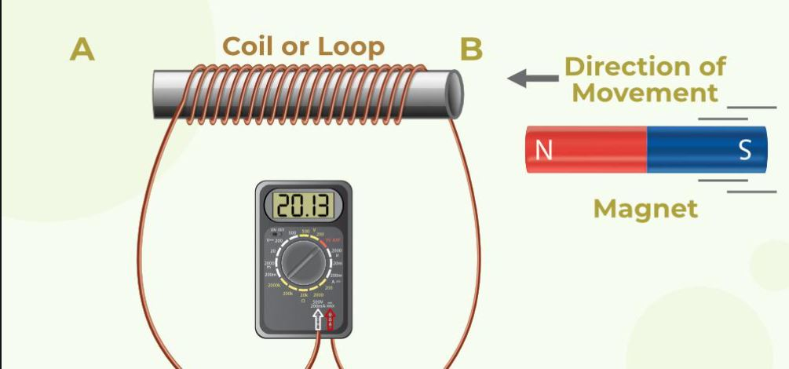
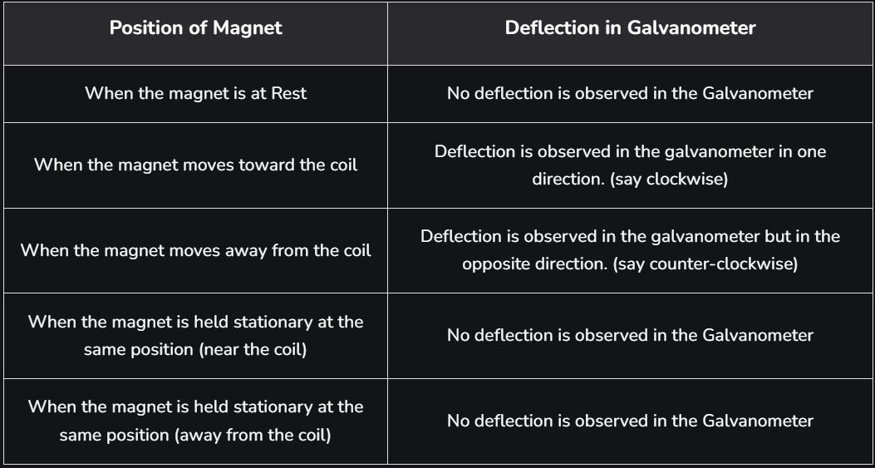
Working

Slide 8
FAQs(Frequently Asked Questions)
Q. Why are Faraday’s Laws important?
Answer: Faraday’s laws are used to define the EMF produce inside a coil if it rotates in a magnetic field. This concept is widely used in modern-day physics.
Q. What is meant by EMF?
Answer: EMF refers to Electromotive Force and is the energy required to flow the current in the circuit.
What is meant by induced current?
Answer: Induced current is generated due to the EMF induced in circuit due to the relative motion between coil and magnet.

Slide 9
Applications
Various applications of the Faraday laws are:
Faraday’s Law is used in electrical equipment like transformers and electric motors.
Faraday’s law is also helpful in designing musical instruments like the electric guitar, electric violin, and others
It explains the forces acting on the electric circuit by the electromagnetic field.

Slide 10
Solved Numericals
1. The magnetic flux linked with a coil 4 turns is changed from 2Wb to 0.2Wb in 0.5 seconds. Calculate the induced EMF.
Solution:
Δⲫ = 2-0.2 = 1.8wb
Δt = 0.5 sec
E = -N(Δⲫ/Δt)
E= -4(1.8/0.5) volts
E= 4x3.6= -14.4 volts
Therefore, induced emf will be -14.4 volts.

Slide 11
2. Calculate the EMF induced in the wire. When a small piece of metal wire with 2 turns is dragged across the gap between the pole pieces of a magnet in 0.5sec. The magnetic flux between the pole pieces is known to be 9×10^-4 Wb.
Solution:
dt = 0.5 s
dⲫ = 9×10^-4 = 9×10^-4 Wb
E = -N(dⲫ/dt)
E= -2(9×10^-4/0.5)
E= -0.0036 V
Therefore, the induced emf -0.0036V

Slide 12
Conclusion
Faraday in his laws states that an EMF is induced when there is a relative motion between the magnet and the conducting coil or when there is change in magnetic flux. If it is a closed circuit, an induced current is observed flowing through the circuit.

Slide 13
Any Questions?

Slide 14
THANK YOU!

